Slide 1
Ecological Data Repositories & Field Platforms
Phemelo Rutlokoane

Slide 2
Ecological Data Repositories & Field Platforms
Harnessing Open Ecological Data for Research at Scale Phemelo Rutlokoane — 2025

Slide 3
Why Ecological Data Matters
Ecological systems are complex and variable
Long-term, large-scale data is needed
Open science = reproducibility + collaboration

Slide 4
Defining the Landscape
Open data repositories
Field campaign platforms
Global and local examples
Emphasis on FAIR principles

Slide 5
GBIF – Global Biodiversity Info Facility
Billions of species occurrence records
Darwin Core metadata standards
Strengths: scale, openness, citation
Limits: bias, lack of absences

Slide 6
NEON – U.S. Observatory Network
81 sites across eco-climatic zones
Sensors + remote sensing + biotic surveys
Standardised, API-supported
Limits: only U.S., complexity

Slide 7
PANGAEA – Earth & Env Data
Multidisciplinary georeferenced data
Curated metadata + DOIs
Excellent for oceanography, climate
Limits: mostly static data

Slide 8
LTER – Long Term Ecological Research
U.S.-based, site-level long-term studies
Rich temporal resolution
Data via EDI (Environmental Data Initiative)
Limits: site heterogeneity

Slide 9
SAEON – South Africa’s Network
Long-term ecological monitoring
Marine, terrestrial, limnology
Data platform: ulwazi.saeon.ac.za
Strength: National integration

Slide 10
DataONE – Aggregated Access
Portal indexing datasets from many sources
Emphasis on metadata, discoverability
Supports Data Packages
Limits: metadata consistency

Slide 11
Atlas of Living Australia (ALA)
Species distribution + citizen science
Portal and analytical tools
Linked to GBIF
Limits: Australia-specific

Slide 12
Case Study 1: Climate & Phenology
GBIF + LTER = flowering time shifts
Global warming signal evident

Slide 13
Case Study 2: Invasives & Risk
ALA + DataONE = species distribution models
Applied to biosecurity and risk mapping

Slide 14
Case Study 3: Ecosystem Services
PANGAEA + SAEON: marine biodiversity + carbon flux
Ecological economics

Slide 15
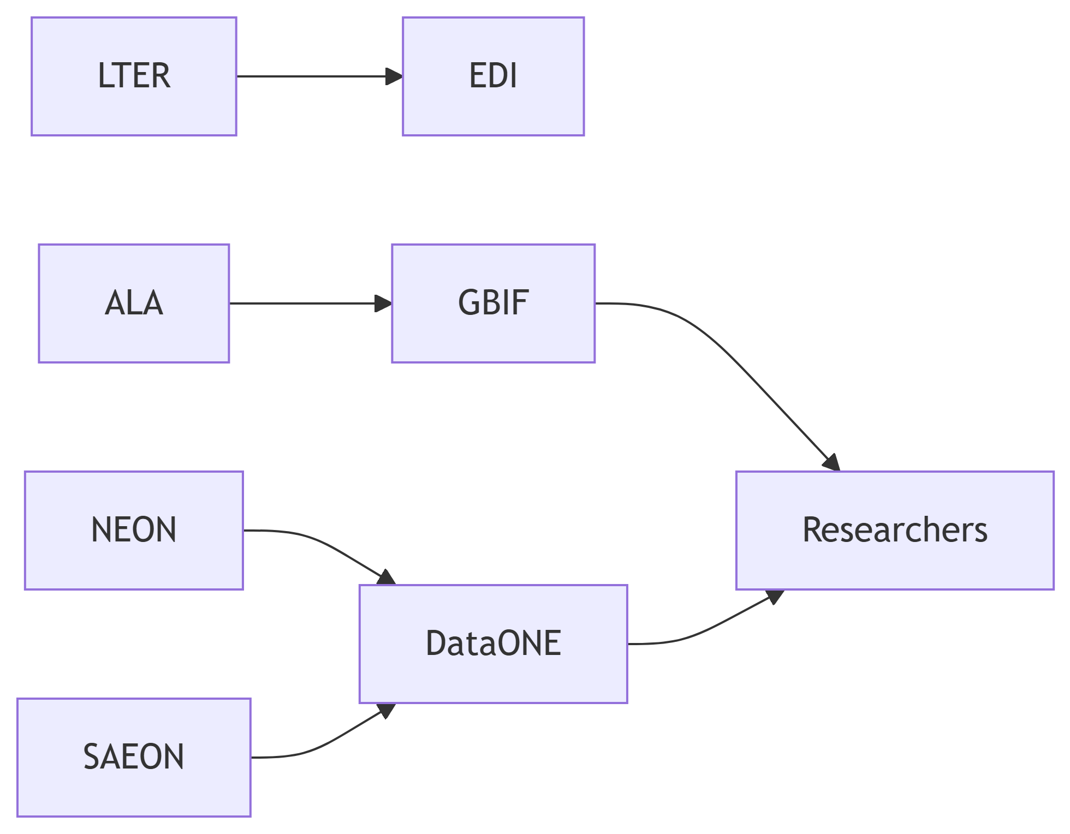
Integration and Data Flows

